Slide 1
Exploratory Data Analysis
& Supervised Machine Learning
Univariate · Bivariate · Multivariate Analysis · ML Model Evaluation
Prepared by: Namrata Farmer
Prepared for: NextHikes IT Solutions

Slide 2
Dataset Overview
15,000
12
5
4
Total Records
Original Columns
Industries
Countries
Original Columns
id (dropped)
annual_revenue_million
company_name
profit_margin_percent
industry
founded_year
country
customer_count
region
market_rating
employee_count
created_date (dropped)
Target Variable: annual_revenue_million

Slide 3
Data Preprocessing & Quality Checks
No Duplicate Records
Company Name Cleaned
df.duplicated().sum() returned 0 — dataset is entirely unique across all 15,000 records.
Appended ID suffixes (e.g. FinTrust_14996) stripped; only the base company name retained.
No Null Values
created_date Dropped
df.info() confirmed complete data across all 12 columns — no imputation required.
No direct relationship with business features like revenue, profit margin, or market rating. Excluded during feature engineering.
Datatype Correction
region Column Dropped
created_date converted from string (str) to datetime using format '%d-%m-%Y' for proper temporal handling.
Region is derived from country — retaining both creates redundant information. country retained as it carries richer market-level context.
id Column Dropped
company_name Dropped
The id column serves no analytical or predictive purpose — removed to avoid noise in the model.
One-to-one mapping with industry — redundant feature. industry retained for broader analytical generalizability.

Slide 4
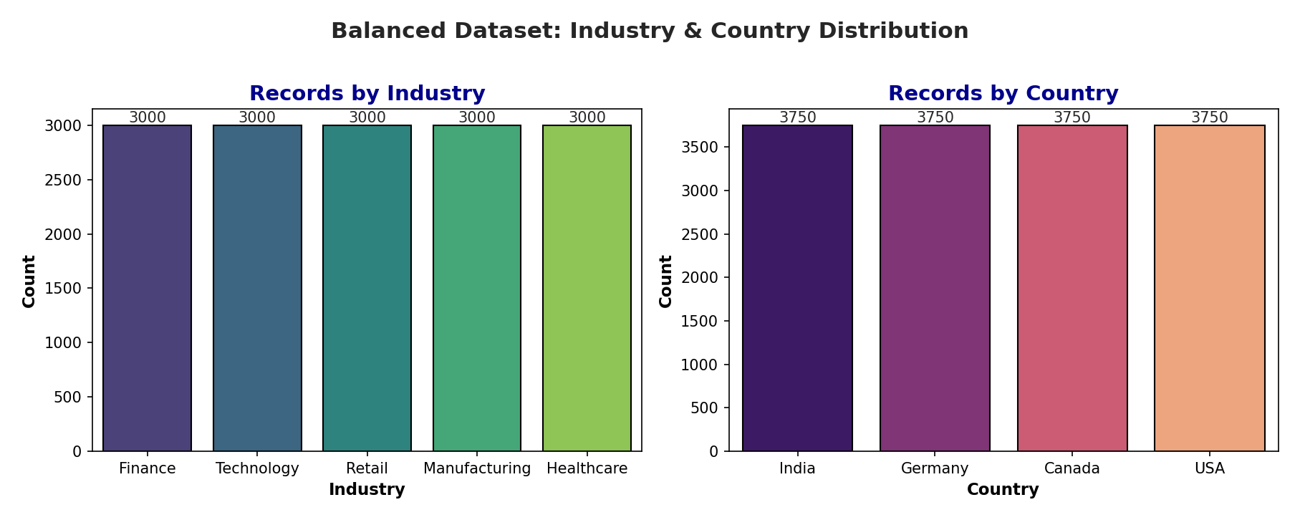
Univariate Analysis — Categorical Variables
Perfectly Balanced Industries
Each of the 5 industries — Finance, Healthcare, Manufacturing, Retail, Technology — contains exactly 3,000 records.
Uniform Country Distribution
All 4 countries — India, Germany, Canada, USA — contribute exactly 3,750 records each.
No Overrepresentation Bias
Balanced distribution eliminates sector or geographic bias in EDA and model building.

Slide 5
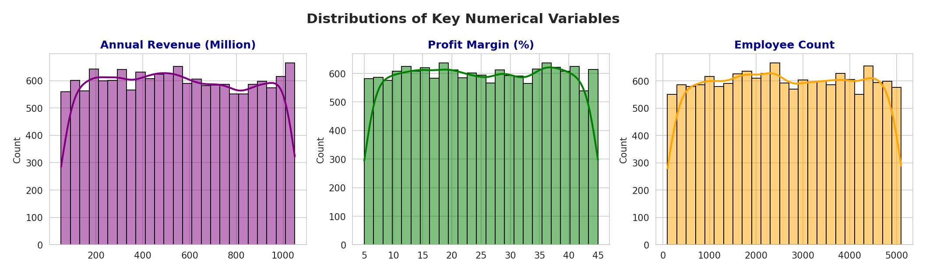
Univariate Analysis — Numerical Variables
Box Plot — Outlier Detection (Numerical Columns)
▸ All numerical variables appear well distributed across their ranges, with no major outliers visible in any box plot.
▸ The median line sits at the centre of every box, indicating the distributions are fairly symmetrical.
▸ Employee count, revenue, profit margin, customer count, founded year and market rating all show clean, balanced spreads.
▸ Overall, the dataset is clean and balanced with no extreme outliers requiring treatment before modelling.

Slide 6
Feature Engineering — Derived Categorical Columns
revenue_category
Low · Mid-Low · Mid-High · High
Enables revenue-tier analysis without scale distortion
profit_category
Very Low → Very High Profit
Categorizes operational efficiency across standard profit ranges
rating_category
Low (<2) · Medium (2–4) · High (≥4)
Converts continuous market_rating to interpretable sentiment tiers
customer_category
Very Low → Very High Customers
Segments customer scale for bivariate and multivariate comparison
founded_period
1990s · 2000s · 2010s
Groups company age into business generations for cohort analysis

Slide 7
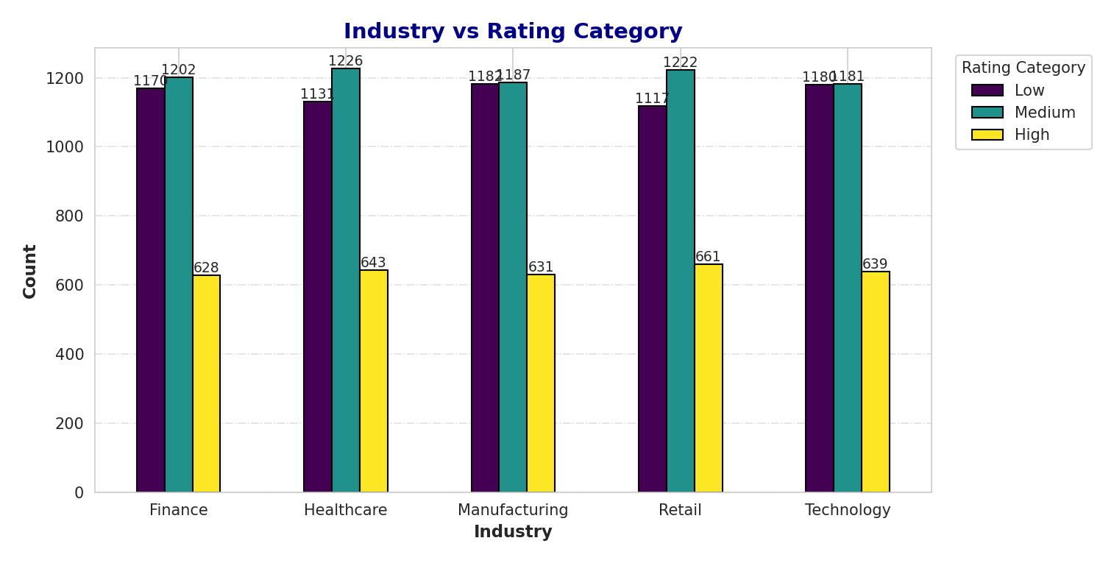
Bivariate Analysis — Industry-Level Performance
Key Insight: Medium-rated companies dominate across all industries. Retail contains the largest number of High-rated companies, while Manufacturing and Technology exhibit the highest count of Low-rated companies. Overall, the rating distribution is broadly similar across all five industries.

Slide 8
Bivariate Analysis — Country-Level Insights
Revenue Distribution
Profit Margin
All 4 countries show near-identical revenue distributions. India marginally leads in the Very High revenue tier. USA maintains a strong High segment.
Average profit margin hovers around 25% across all countries. India shows a marginal advantage at 25.1%. No country significantly outperforms.
Employee Count
Customer Count
Germany and USA companies are marginally larger on average but differences are negligible. Canada shows relatively stronger presence of smaller firms.
Canada leads slightly in High and Very High customer categories. Average customer count varies minimally across all countries.
Market Rating
Founded Period
Average rating is identical (2.5) across all countries — global uniformity in market perception. Medium ratings dominate in every geography.
All countries share an average founding year of 2004, indicating similar business maturity levels. The 2000s represent the peak founding decade globally.

Slide 9
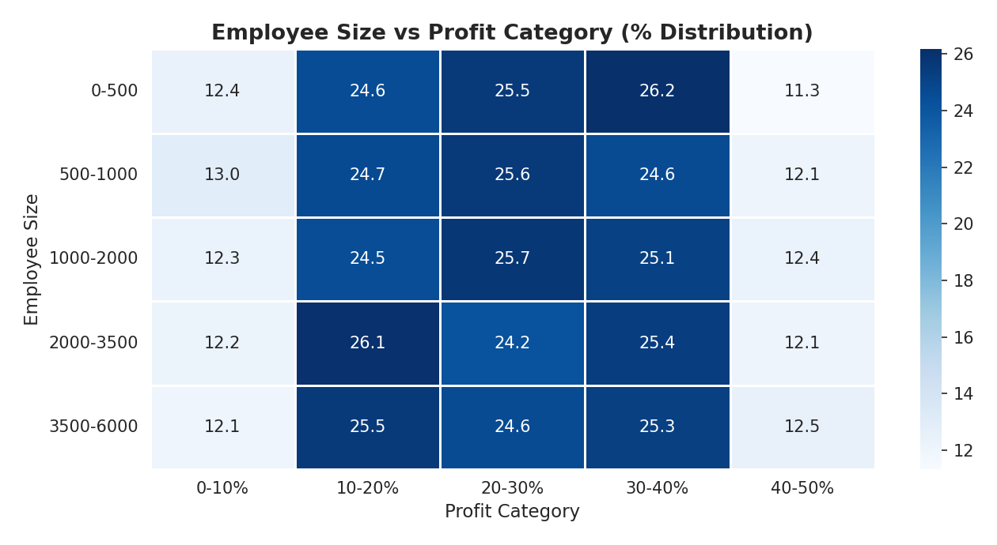
Bivariate Analysis — Employee Count Relationships
▸ Profit margin percentage does NOT increase with employee size — all employee-size bands show nearly identical profit distributions.
▸ Companies grow in scale but NOT in efficiency: workforce expansion does not translate into superior margin performance.
▸ Larger firms (3500–6000 employees) show the highest customer counts, but customer acquisition is not solely driven by workforce size.
▸ Market ratings are spread uniformly across all employee-size categories — workforce size has limited influence on market perception.

Slide 10
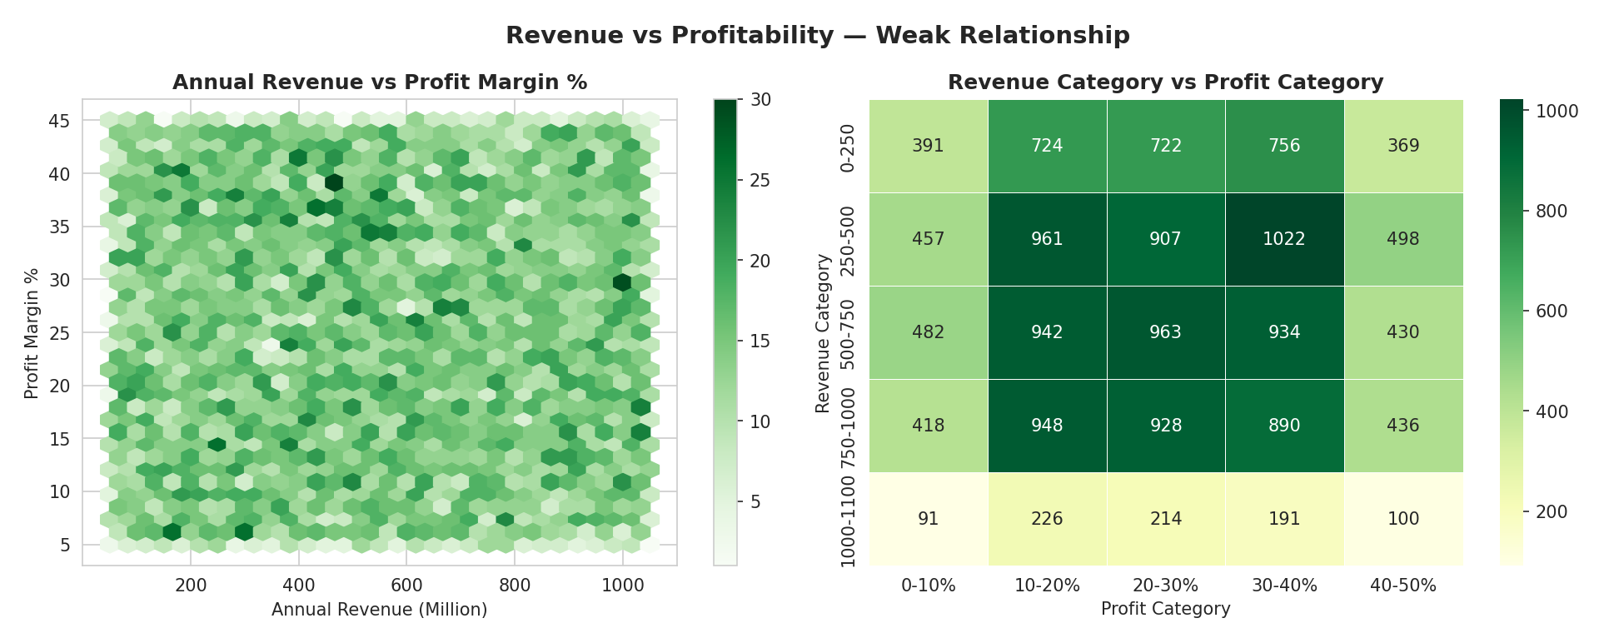
Bivariate Analysis — Revenue, Profitability & Market Rating
Revenue ≠ Profitability:
High revenue does not guarantee high profit margins. Profit distributions are nearly identical across all revenue bands.
Mid-Market Dominance:
250–750M revenue range accounts for the majority of firms across all analysis dimensions — most competitive zone.
Medium Rating Plateau:
Across all revenue, customer, and profit tiers, Medium-rated companies dominate — high ratings remain scarce even among top performers.
Weak Feature-Target Correlation:
None of the available features exhibit a meaningful linear or non-linear relationship with annual_revenue_million.

Slide 11
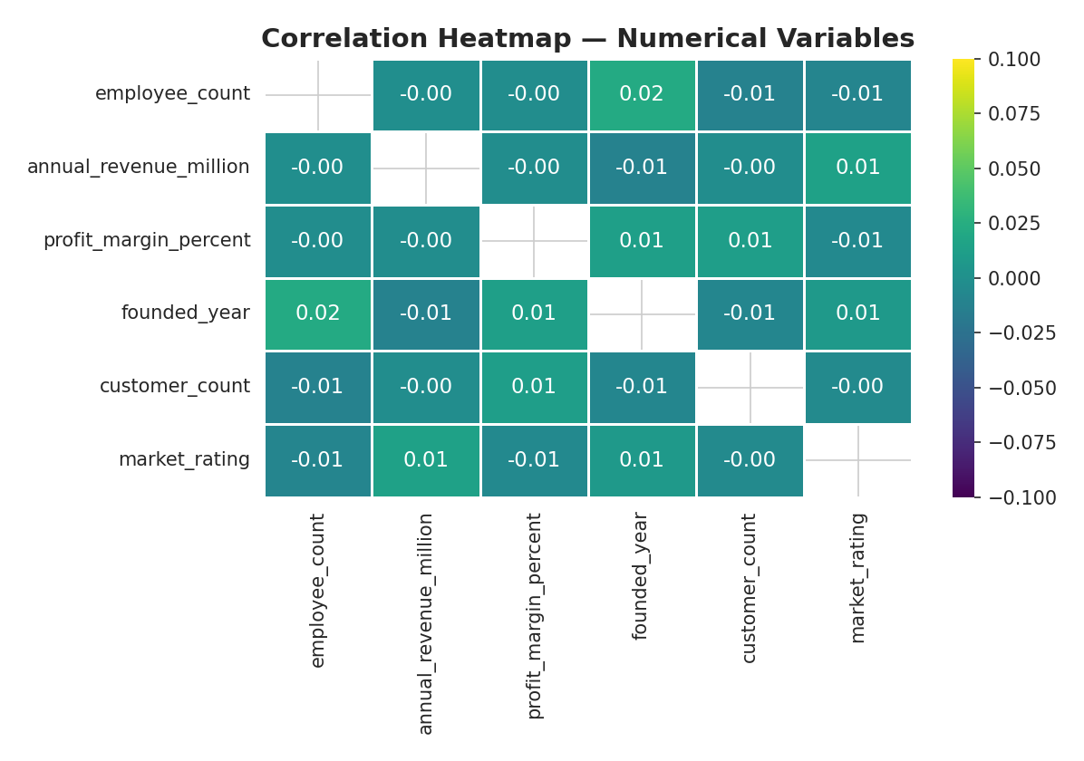
Multivariate Analysis — Correlation Heatmap
Critical Finding: All pairwise correlations lie between −0.01 and +0.02 — virtually NO linear relationship between any feature and annual_revenue_million. Minimal multicollinearity, but also minimal predictive signal for supervised regression.

Slide 12
Machine Learning — Setup & Methodology
1. Target Variable
Models Evaluated
annual_revenue_million selected as the dependent variable (y). All remaining columns form the feature matrix (X).
Linear Regression
2. Engineered Columns Dropped
Lasso Regression
rating_category, employee_size, revenue_category, profit_category, founded_period, customer_category excluded — these are derived from features already in X.
Ridge Regression
3. Encoding
Elastic Net
One-hot encoding (pd.get_dummies, drop_first=True) applied to industry and country columns to convert categoricals into numerical format.
Decision Tree Regressor
4. Train / Test Split
80% Training / 20% Test split using train_test_split with random_state=42 for reproducibility.
Random Forest Regressor
SVR (Support Vector Regression)
5. Feature Scaling
StandardScaler applied — fit on train set, transform applied to both train and test sets to prevent data leakage.
KNN Regressor

Slide 13
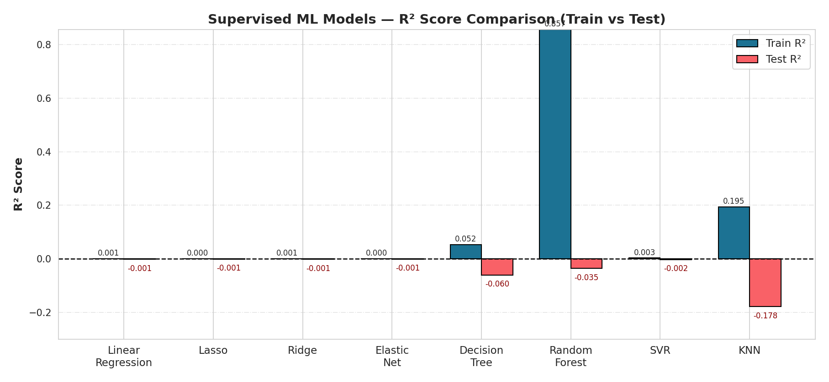
ML Model Performance — R² Score Comparison
All models produced negative Test R² scores — a predictor worse than a simple mean baseline.
Best Test R²
Worst Test R²
Train ≫ Test
-0.0005
-0.1783
0.857 vs -0.035
Lasso & Elastic Net
KNN Regressor
Random Forest (Overfit)

Slide 14
Why No Model Fit the Dataset — Root Cause Analysis
Near-Zero Feature Correlations
Uniform Dataset Structure
≈0
The correlation heatmap revealed that all pairwise correlations lie between −0.01 and +0.02. No feature shows a meaningful linear or non-linear association with annual_revenue_million — the target variable cannot be explained by the available predictors.
⊟
The dataset was designed with perfectly balanced distributions across industries (3,000 each), countries (3,750 each), and all numerical columns. This structural uniformity means there are no patterns, clusters, or gradients for any model to learn.
Overfitting in Tree-Based Models
Revenue Determined by Non-Available Factors
⚠
Random Forest achieved a Train R² of 0.857 but collapsed to a Test R² of −0.035, confirming severe overfitting. The model memorized noise rather than generalising any signal. Decision Tree and KNN showed similar train-test divergence.
∅
EDA consistently showed that employee count, customer count, profit margin, market rating, and founded year do NOT significantly influence annual revenue within this dataset. Revenue appears to be independently distributed — likely controlled by the data generation process rather than real-world business dynamics.
No Separability Across Categorical Features
Target Variable Behaves as Random Noise
=
Industry type and country of operation showed no differentiating power over revenue. After one-hot encoding, these features added no predictive signal, as revenue distributions within each industry and country are virtually identical.
~
The flat distribution of annual_revenue_million (Mean ≈ 550M, Std Dev ≈ 288M, uniform KDE) and near-zero correlations with all features suggest the target behaves as a uniformly distributed random variable — regression models cannot outperform a constant mean predictor on such data.

Slide 15
Conclusion
EDA Coverage
Conducted comprehensive Univariate, Bivariate, and Multivariate analysis across 15,000 records and 12 columns. Five new engineered features derived for deeper categorical insight.
Dataset Characteristics
The dataset is structurally uniform — all industries, countries, and numerical variables exhibit near-identical, balanced distributions with no dominant patterns or clusters.
Correlation Finding
Pairwise correlations between all numerical variables fall within −0.01 to +0.02, indicating virtually no linear relationships and minimal predictive signal for the target variable.
Model Evaluation
Eight supervised ML models — Linear Regression, Lasso, Ridge, Elastic Net, Decision Tree, Random Forest, SVR, and KNN — were applied. All produced negative Test R² scores.
Best Performing Model
Lasso Regression and Elastic Net achieved the highest Test R² (−0.0005), though performance remained statistically weak. Random Forest exhibited severe overfitting (Train R²: 0.857, Test R²: −0.035).
Final Verdict
None of the supervised machine learning models best fit the dataset. The uniform data structure, near-zero feature correlations, and independently distributed target variable render the dataset unsuitable for reliable supervised regression under the given feature set.

